Slide 1
Computer Networks
Lecture 7: Application Layer
Prepared and modified by:
Assoc.Prof.Dr. Hossam Mahmoud Moftah
Associate Professor – Faculty of Computers and Artificial Intelligence– Beni-Suef University

Slide 2
Chapter 2: outline
2.1 principles of network applications
  app architectures
  app requirements
2.2 Web and HTTP
2.3 FTP
2.4 electronic mail
  SMTP, POP3, IMAP
2.5 DNS
2.6 P2P applications
2.7 socket programming with UDP and TCP
Application Layer
2-<number>

Slide 3

Electronic mail
outgoing
message queue
user mailbox
Three major components:
user agents
mail servers
simple mail transfer protocol: SMTP
User Agent
a.k.a. “mail reader”
composing, editing, reading mail messages
e.g., Outlook, Thunderbird, iPhone mail client
outgoing, incoming messages stored on server
user
agent
mail
server
user
agent
SMTP
mail
server
user
agent
SMTP
SMTP
user
agent
mail
server
user
agent
user
agent
Application Layer
2-<number>

Slide 4
Electronic mail: mail servers
mail servers:
mailbox contains incoming messages for user
message queue of outgoing (to be sent) mail messages
SMTP protocol between mail servers to send email messages
  client: sending mail server
  “server”: receiving mail server
user
agent
mail
server
user
agent
SMTP
mail
server
user
agent
SMTP
SMTP
user
agent
mail
server
user
agent
user
agent
Application Layer
2-<number>

Slide 5
Electronic Mail: SMTP [RFC 2821]
uses TCP to reliably transfer email message from client to server, port 25
direct transfer: sending server to receiving server
three phases of transfer
  handshaking (greeting)
  transfer of messages
  closure
command/response interaction (like HTTP, FTP)
  commands: ASCII text
  response: status code and phrase
messages must be in 7-bit ASCI
Application Layer
2-<number>

Slide 6


Scenario: Alice sends message to Bob
1) Alice uses UA to compose message “to” bob@someschool.edu
2) Alice’s UA sends message to her mail server; message placed in message queue
3) client side of SMTP opens TCP connection with Bob’s mail server
4) SMTP client sends Alice’s message over the TCP connection
5) Bob’s mail server places the message in Bob’s mailbox
6) Bob invokes his user agent to read message
user
agent
mail
server
user
agent
1
mail
server
2
3
6
4
Alice’s mail server
5
Bob’s mail server
Application Layer
2-<number>

Slide 7
Chapter 2: outline
2.1 principles of network applications
  app architectures
  app requirements
2.2 Web and HTTP
2.3 FTP
2.4 electronic mail
  SMTP, POP3, IMAP
2.5 DNS
2.6 P2P applications
2.7 socket programming with UDP and TCP
Application Layer
2-<number>

Slide 8
SMTP and Comparison with HTTP
SMTP uses persistent connections
SMTP requires message (header & body) to be in 7-bit ASCII
SMTP server uses CRLF.CRLF to determine end of message
comparison with HTTP:
both have ASCII command/response interaction, status codes
HTTP: each object encapsulated in its own response msg
SMTP: multiple objects sent in multipart msg
Application Layer
2-<number>

Slide 9
Mail message format
SMTP: protocol for exchanging email msgs
RFC 822: standard for text message format:
header lines, e.g.,
  To:
  From:
  Subject:
Body: the “message”
  ASCII characters only
header
blank
line
body
Application Layer
2-<number>

Slide 10
Mail access protocols
user
agent
mail access
protocol
user
agent
SMTP
SMTP
(e.g., POP,
IMAP)
sender’s mail
server
receiver’s mail
server
SMTP: delivery/storage to receiver’s server
mail access protocol: retrieval from server
  POP: Post Office Protocol [RFC 1939]: authorization, download
  IMAP: Internet Mail Access Protocol [RFC 1730]: more features, including manipulation of stored msgs on server
  HTTP: gmail, Hotmail, Yahoo! Mail, etc.
Application Layer
2-<number>

Slide 11
POP3 protocol
S: +OK POP3 server ready
C: user bob
S: +OK
C: pass hungry
S: +OK user successfully logged on
authorization phase
client commands:
  user: declare username
  pass: password
server responses
  +OK
  -ERR
transaction phase, client:
list: list message numbers
retr: retrieve message by number
dele: delete
quit
C: list
S: 1 498
S: 2 912
S: .
C: retr 1
S: <message 1 contents>
S: .
C: dele 1
C: retr 2
S: <message 2 contents>
S: .
C: dele 2
C: quit
S: +OK POP3 server signing off
Application Layer
2-<number>

Slide 12
POP3 (more) and IMAP
more about POP3
previous example uses POP3 “download and delete” mode
  Bob cannot re-read e-mail if he changes client
POP3 “download-and-keep”: copies of messages on different clients
POP3 is stateless across sessions
IMAP
keeps all messages in one place: at server
allows user to organize messages in folders
keeps user state across sessions:
  names of folders and mappings between message IDs and folder name
Application Layer
2-<number>

Slide 13
Chapter 2: outline
2.1 principles of network applications
  app architectures
  app requirements
2.2 Web and HTTP
2.3 FTP
2.4 electronic mail
  SMTP, POP3, IMAP
2.5 DNS
2.6 P2P applications
2.7 socket programming with UDP and TCP

Slide 14
Socket programming
goal: learn how to build client/server applications that communicate using sockets
socket: door between application process and end-end-transport protocol
application
socket
application
controlled by
app developer
process
process
transport
transport
network
network
controlled
by OS
link
Internet
link
physical
physical

Slide 15
Socket programming
  Two socket types for two transport services:
  UDP: unreliable datagram
  TCP: reliable, byte stream-oriented
  Application Example:
Client reads a line of characters (data) from its keyboard and sends the data to the server.
The server receives the data and converts characters to uppercase.
The server sends the modified data to the client.
The client receives the modified data and displays the line on its screen.

Slide 16
Socket programming (TCP vs. UDP)
UDP or Datagram communication:
The datagram communication protocol, known as UDP (user datagram protocol), is a connectionless protocol, meaning that each time you send datagrams, you also need to send the local socket descriptor and the receiving socket's address.
TCP or Stream communication:
The stream communication protocol is known as TCP (transfer control protocol). Unlike UDP, TCP is a connection-oriented protocol. In order to do communication over the TCP protocol, a connection must first be established between the pair of sockets. While one of the sockets listens for a connection request (server), the other asks for a connection (client). Once two sockets have been connected, they can be used to transmit data in both (or either one of the) directions.

Slide 17
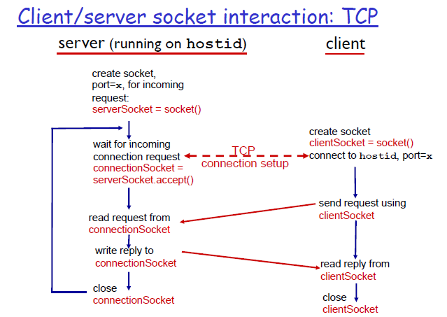
Socket programming

Slide 18
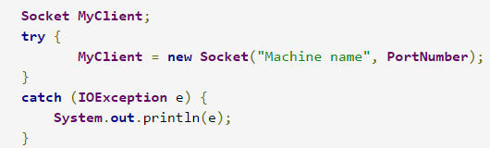
Programming sockets in Java
client
If you are programming a client, then you would open a socket like this:

Slide 19
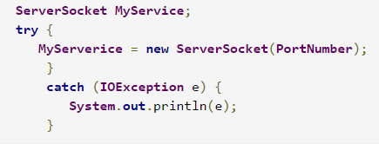
Programming sockets in Java
Server
If you are programming a server, then this is how you open a socket: :

Slide 20
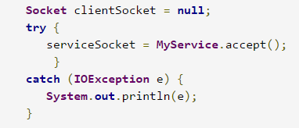
Programming sockets in Java
Server
When implementing a server you also need to create a socket object from the ServerSocket in order to listen for and accept connections from clients.

Slide 21
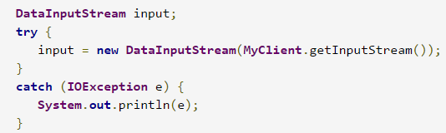
Programming sockets in Java
Client
How do I create an input stream?
On the client side, you can use the DataInputStream class to create an input stream to receive response from the server:
The class DataInputStream allows you to read lines of text and Java primitive data types in a portable way. It has methods such as read, readChar, readInt, readDouble, and readLine.

Slide 22
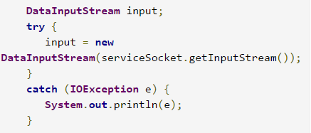
Programming sockets in Java
Server
On the server side, you can use DataInputStream to receive input from the client:

Slide 23
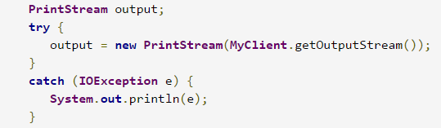
Programming sockets in Java
Client
How do I create an output stream?
On the client side, you can create an output stream to send information to the server socket using the class PrintStream or DataOutputStream of java.io:

Slide 24
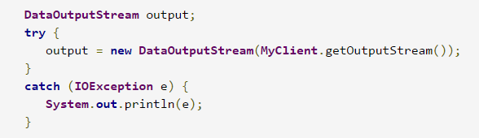
Programming sockets in Java
Client
OR by using DataOutputStream class

Slide 25
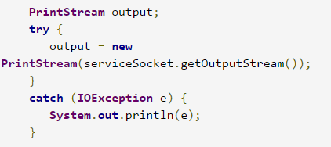
Programming sockets in Java
Server
On the server side, you can use the class PrintStream to send information to the client.
Note: You can use the class DataOutputStream as mentioned above.

Slide 26
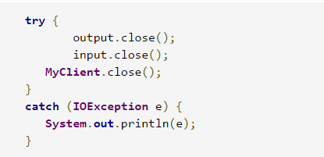
Programming sockets in Java
How do I close sockets?
You should always close the output and input stream before you close the socket.
Client
On the client side:

Slide 27
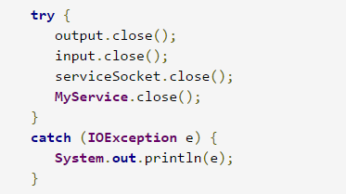
Programming sockets in Java
Server
On the server side:

Slide 28
Programming sockets in Java
Examples
1- SMTP client
Let's write an SMTP (simple mail transfer protocol) client -- one so simple that we have all the data encapsulated within the program.
When programming a client, you must follow these four steps:
  Open a socket.
  Open an input and output stream to the socket.
  Read from and write to the socket according to the server's protocol.
  Clean up.

Slide 29
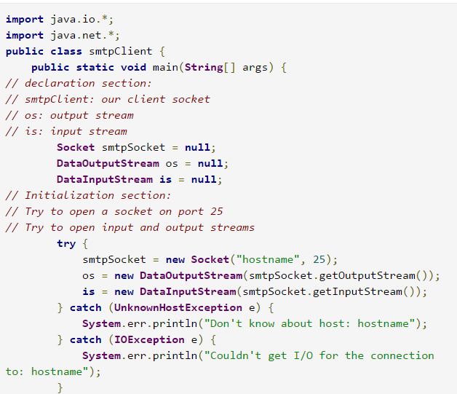
Programming sockets in Java

Slide 30
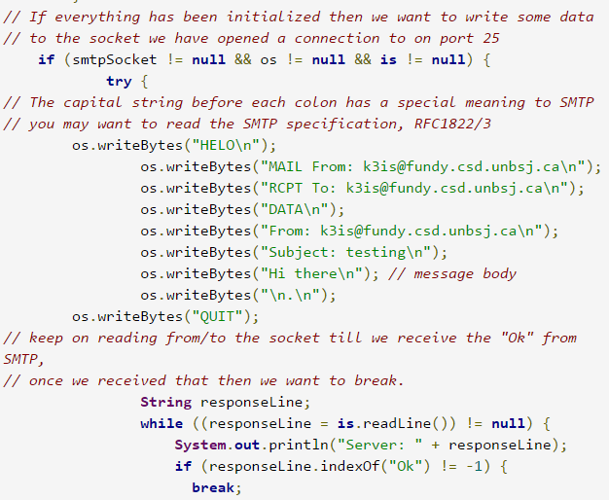
Programming sockets in Java

Slide 31
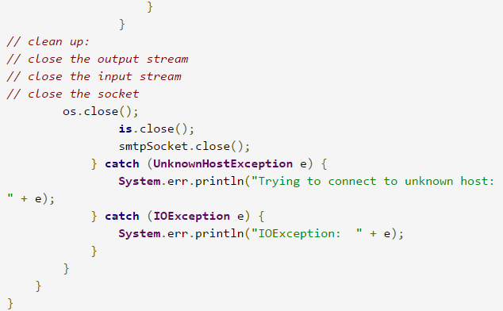
Programming sockets in Java

Slide 32
The end
Application Layer
2-<number>

